Slide 1
What is an SAE?
Norfolk FFA Chapter

Slide 2
Ag Education Model
Classroom Work
FFA Activities
SAE program

Slide 3
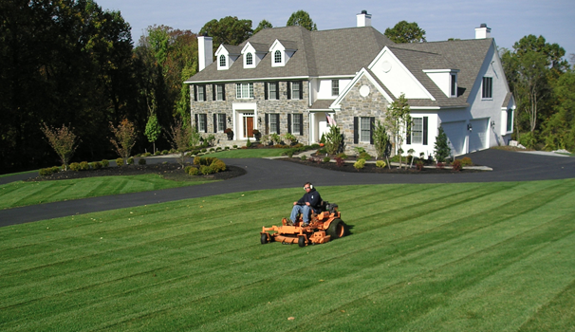
SAE
Supervised Agricultural Experience
agriculturally related work experience outside of class time
some in school lab hours count as well

Slide 4
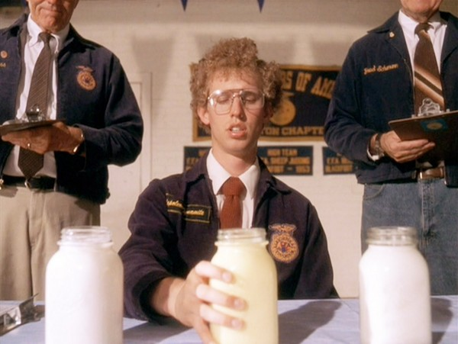
What’s the point?
apply the skills you learn in class
gain valuable work (and life) skills
make money
build new skills and connections in your area of interest

Slide 5
Who can have an SAE?
any FFA member (so that’s everyone) is encouraged to have an SAE
it doesn’t have to be in your major
so you can be a Floriculture major and have an SAE in Beef Production
you can be an Equine major and have an SAE in Turfgrass Management
there are tons of different areas you can have your SAE in

Slide 6
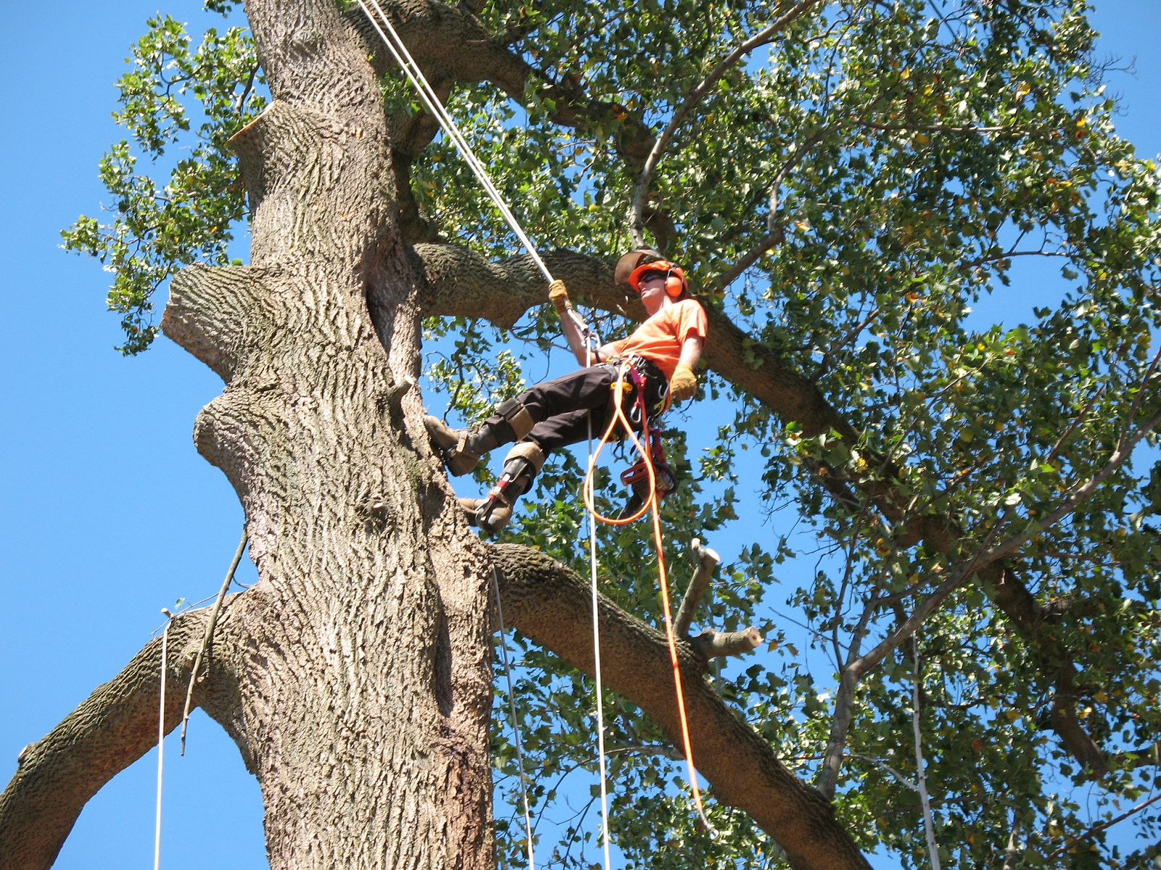
Entrepreneurship
student owns and runs a small business
EX: lawn mowing service
student makes money
student invests their own money into the business

Slide 7
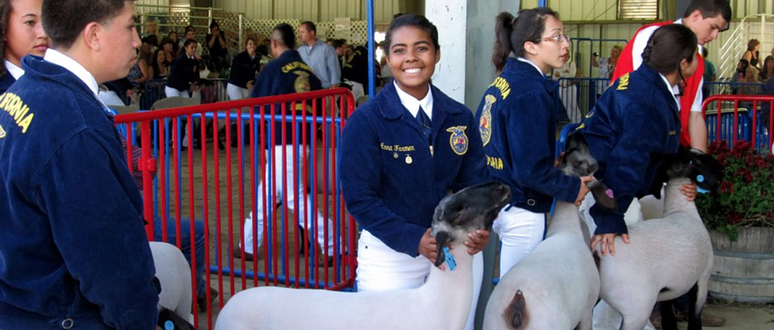
Placement / Internship
student works for a person or business (or does an internship)
EX: working in a garden center or kennel
measured in hours and income
student doesn’t have to invest money

Slide 8
Research / Analytical
experimental (EX: testing effects of fertilizer)
analytical (EX: collect data about milking cow production on your farm and analyze it)
invention (EX: build a tractor attachment or invent a new integrated fertilizing system)

Slide 9
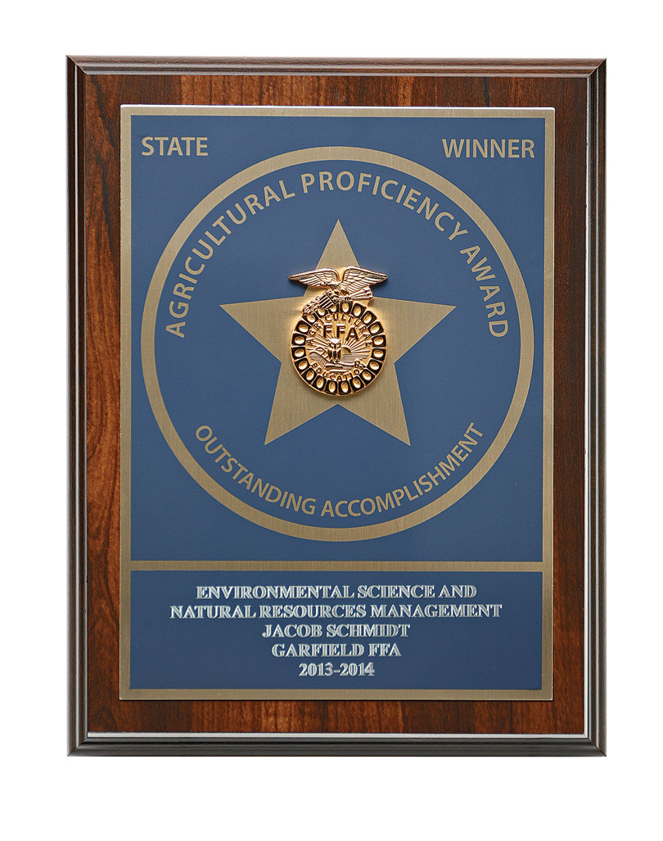
Proficiency Awards
awards for students w/ well developed SAE programs
available at Chapter, State, Regional, and National level
you win $250 at states, and can then go to National Convention with your award

Slide 10
Examples of Prof. Areas
Landscape Management
Dairy Production
Specialty Crop Production (includes any sort of Floriculture SAE)
Diversified Horticulture (2 or more plant science SAES; EX; landscape mgt. / nursery operations)
Equine Science
Beef Production
There are so many more!!!

