Slide 1
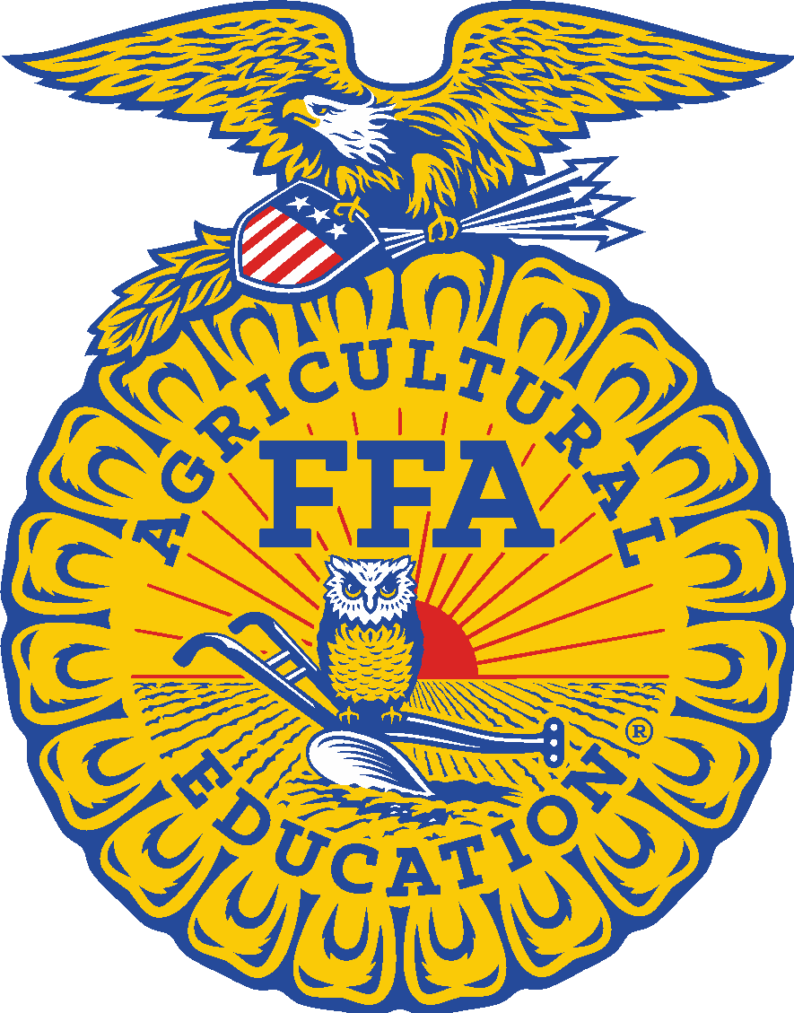
FFA General Information
Norfolk FFA Officers
https://youtu.be/xfy88dsYsE0

Slide 2
What is FFA?
FFA is the largest student run organization world wide
Created in 1928 as the Future Farmers of America
Changed to the National FFA Organization in 1988
not all cows and plows anymore
Over half a million members

Slide 3
The FFA Mission, Vision and Motto
Mission
Premier Leadership, personal growth and career success
Vision
Students whose lives are impacted by FFA and ag education will achieve academic and personal growth. They will provide leadership to build healthy local communities, a strong nation and a sustainable world.

Slide 4
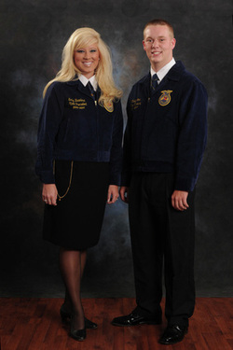
FFA Dress Code
Girls:
Black skirt or pants
White collared blouse
Official FFA blue scarf
Black dress shoes
closed toe and heel
Black tights
FFA jacket zipped to top
no tallywackers!!
Boys:
Black slacks
White collared shirt
FFA necktie
Black dress shoes
Black socks
FFA jacket zipped to the top
no tallywackers!!!

Slide 5
The Emblem
Cross section of the ear of corn
unity
Eagle
freedom
Rising Sun
progress
Owl
knowledge
Words
combination of learning and leadership
Plow
labor and tillage of the soil

Slide 6
The Emblem
The Words
The Eagle
The Rising Sun
The Owl
The Cross Section of the Ear of Corn
The Plow

Slide 7
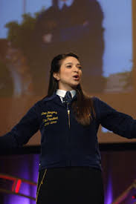
The Creed
A competition for freshmen
5 paragraphs
Compete at chapter, state and national level
Start during classes
Improves your public speaking

Slide 8
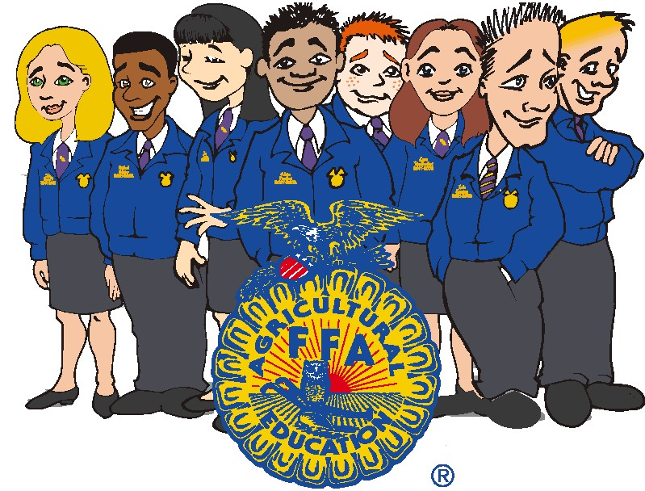
Why it is important?
Make friends who share common interests
Improves leadership qualities
Get to go on cool trips
get out of classes
FFA offers scholarships

Slide 9
How to Get Involved?
Listen to morning announcements
best way to know when events are coming
Come to State Convention
Develop your SAE
Join a CDE
Come to the Freshmen Workshop
Friday, February 26th 2016
develop leadership abilities and learn more about the chapter

Slide 10
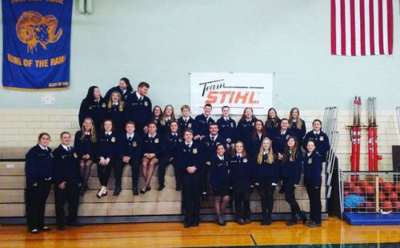
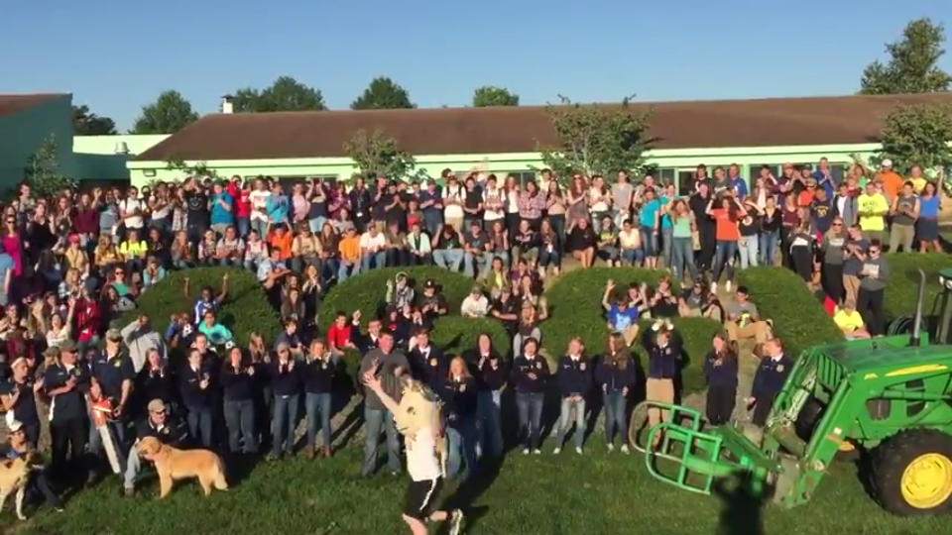
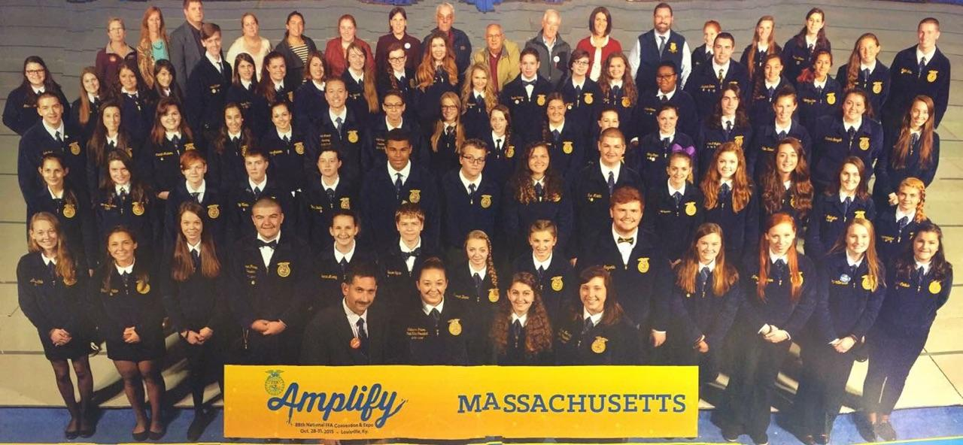
Any Questions?

