Slide 1
Greenhand Degree
Norfolk FFA Chapter

Slide 2
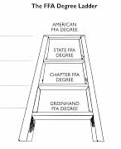
What is it?
It is the first degree that you can receive in the FFA
It is given on the chapter level
It is specifically for first year members
baseline for all other FFA degrees

Slide 3
How is it worn?
it is worn under the member’s name on the jacket
only your highest degree is worn on the outside of the jacket

Slide 4
How do you get the degree?
you have to complete the application and everything required on it then submit it to one of your chapter advisors
you will receive the degree at the FFA banquet in May

Slide 5
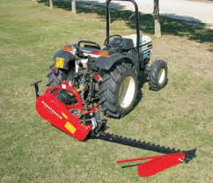
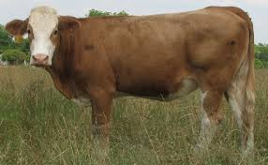
Going through the Application~ Requirement 1
Be enrolled in an agricultural class
write class name (you can use plant, ag-mech, environmental, or animal)

Slide 6
Requirement 2
Have satisfactory plans for a supervised agricultural experience Program (SAE). Attach SAE plan
you can use your working hours in doubles for SAE hours in regards to the greenhand degree
you can also use outside work that you have done
write this out and attach to application

Slide 7
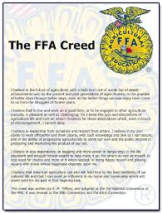
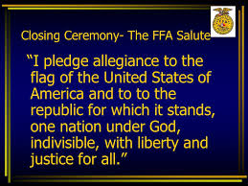
Requirements 3, 4, & 5
Have learned and explained the FFA motto
Have learned and explained the FFA salute
Have learned and explained the FFA creed
you will learn these from other presentations

Slide 8
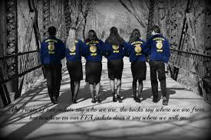
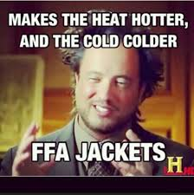
Requirements 6 & 7
Have described and explained the meaning of the FFA emblem and colors
Understand and have explained the FFA Code of Ethics And proper use of the FFA jacket

Slide 9
Requirement 8
Have demonstrated an understanding of the organization’s History, the chapter constitution and bylaws, and the chapter Program of Activities
you will learn these from the other presentations as well

Slide 10
Requirement 9
Own or have access to the Official FFA Manual or the FFA Student Handbook
you have access to the manual through the school or online

